Slide 1

Physical OR Chemical Change?

Slide 2
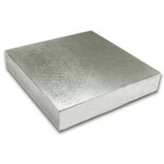
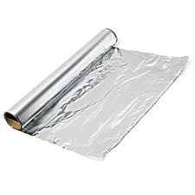
#1 Physical OR Chemical Change?
Before
Piece of Aluminum Metal
After
Sheet of Aluminum Foil
Hammered into

Slide 3
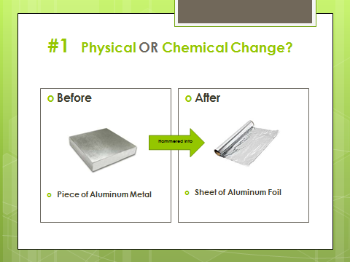
Answer: PHYSICAL

Slide 4
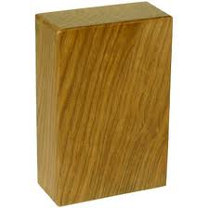
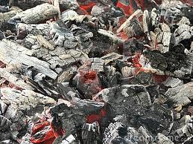
#2 Physical OR Chemical Change?
Before
Wood Block
After
Wood Ashes
burned

Slide 5
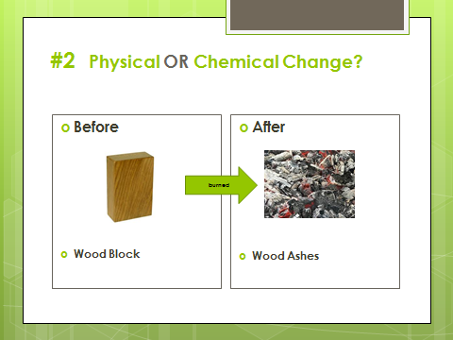
Answer: CHEMICAL

Slide 6

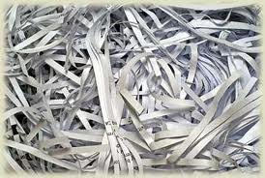
#3 Physical OR Chemical Change?
Before
Sheet of Paper
After
Shredded paper
Torn up

Slide 7
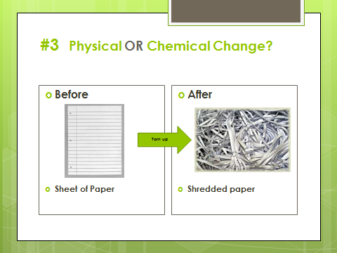
Answer: PHYSICAL

Slide 8
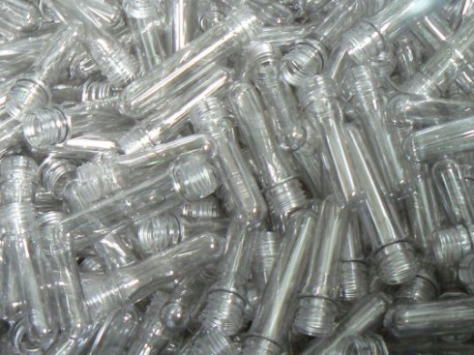
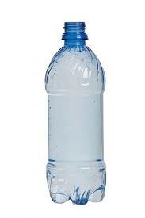
#4 Physical OR Chemical Change?
Before
Plastic form
After
Plastic bottle
Molded

Slide 9
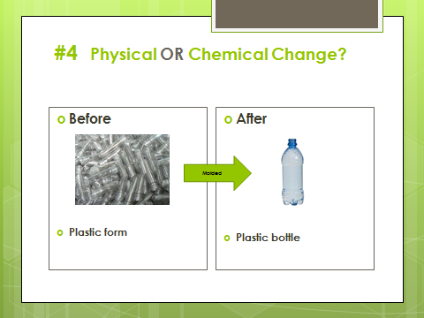
Answer: PHYSICAL

Slide 10
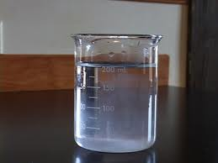
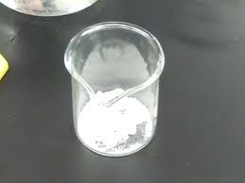
#5 Physical OR Chemical Change?
Before
Salt Water
Before
Salt Crystals
Evaporated

Slide 11
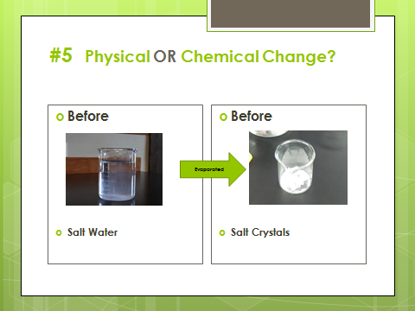
Answer: PHYSICAL

Slide 12
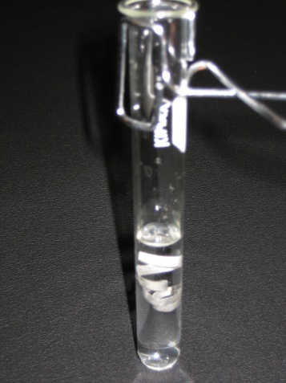
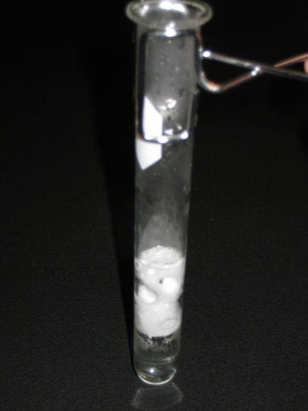
#6 Physical OR Chemical Change?
Before
Magnesium placed in acid
After
Gas bubbles form
React

Slide 13
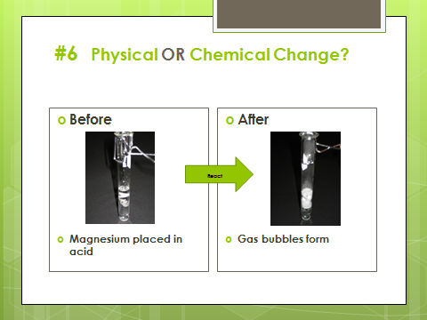
Answer: CHEMICAL

Slide 14


#7 Physical OR Chemical Change?
Before
Magic Ink + vinegar
After
Clear liquid
Color Changes

Slide 15
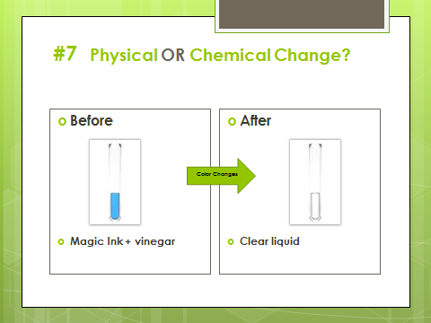
Answer: CHEMICAL

Slide 16
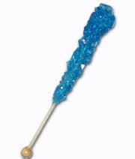
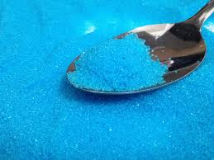
#8 Physical OR Chemical Change?
Before
Large sugar crystals
After
Small sugar crystals
Crushed

Slide 17
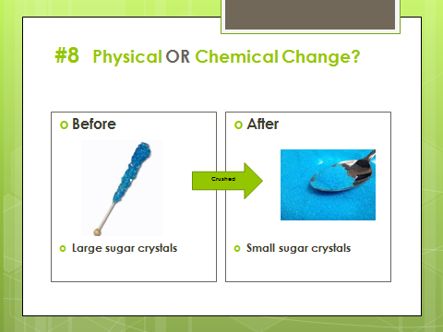
Answer: PHYSICAL

Slide 18
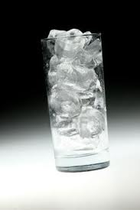
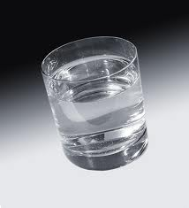
#9 Physical OR Chemical Change?
Before
Ice Cubes
After
Glass of water
Melted

Slide 19
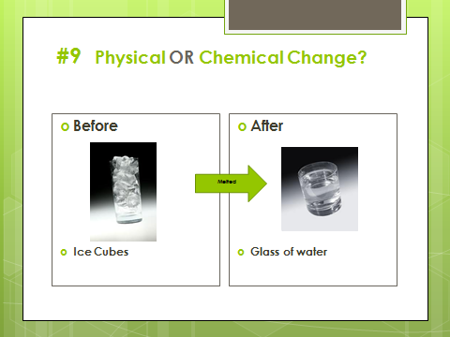
Answer: PHYSICAL

Slide 20
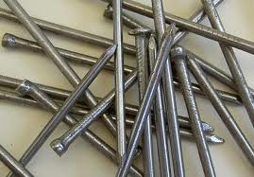
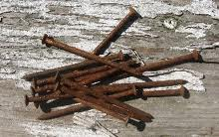
#10 Physical OR Chemical Change?
Before
Iron nails
After
Rusty nails
Exposed to Moisture

Slide 21
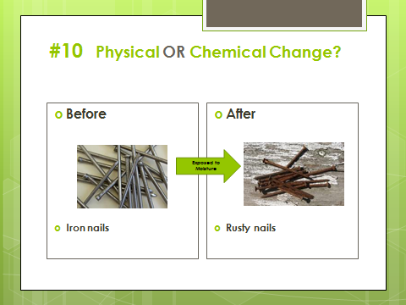
Answer: CHEMICAL

Slide 22
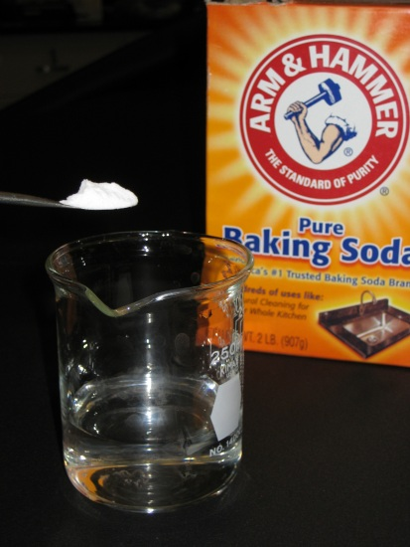
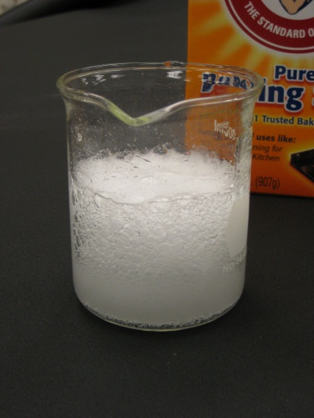
#11 Physical OR Chemical Change?
Before
Vinegar + Baking Soda
After
Fizzing bubbles
React

Slide 23
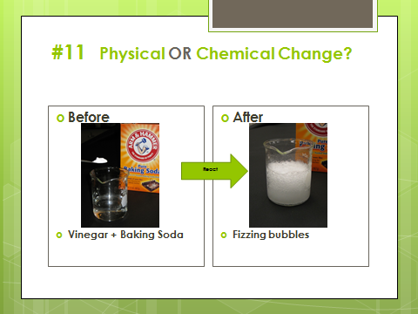
Answer: CHEMICAL

Slide 24
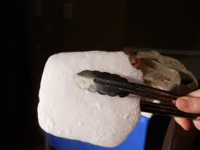
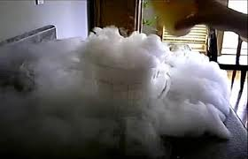
#12 Physical OR Chemical Change?
Before
Solid dry ice
After
Carbon Dioxide Gas
Changes State

Slide 25
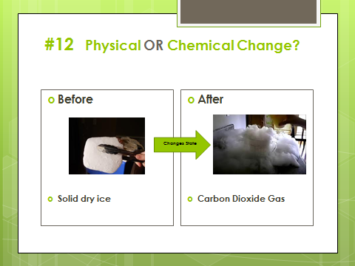
Answer: PHYSICAL

Slide 26
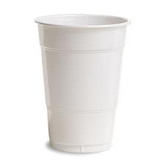
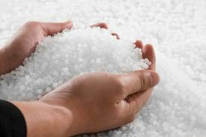
#13 Physical OR Chemical Change?
Before
Plastic pellets
After
Plastic cup
Recycled

Slide 27
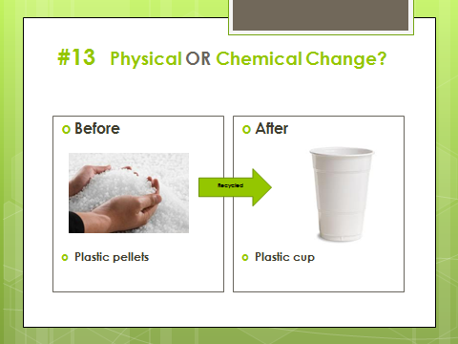
Answer: PHYSICAL

Slide 28
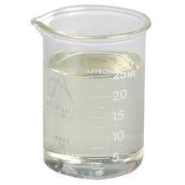
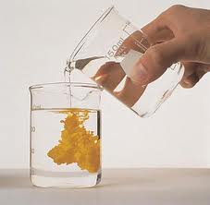

#14 Physical OR Chemical Change?
Before
Two Clear solutions
After
Powdery Yellow solid
React to Form

Slide 29
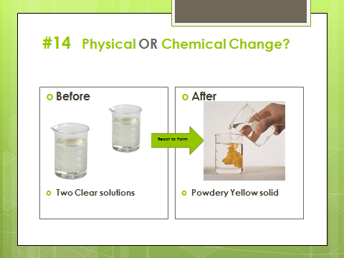
Answer: CHEMICAL

